Slide 1



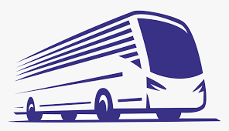
COLLEGE NAME :AMSEC_6202
Building Bus reservation System
STUDENT NAME : R.Manoj
STUDENT ID :620221104016

Slide 2





Project Titel
Web Technologeies Using Django and Python Framework
Bus Reservation System
Abstract | Problem Statement | Project Overview | Technology view | ModellingResult | Screen Shot | Future Enhancement | Conclution

Slide 3
ABSTRACT
Online Bus Ticket Reservation System is a web-based application that works within a file. one network. This project introduces an update to the software program “Online Bus Ticket Reservation System ”as it should be used in the bus system, the area used reserved seats, booking cancellations and various types of route inquiries used for security quick booking. OBTRS is designed to manage and compile a traditional database, ticket booking and bus tracking and departure made. Maintains all customer details, bus details, booking details.

Slide 4
You have been tasked with designing a bus reservation system to facilitate the booking of bus seats for passengers. The system should allow users to view available buses, select seats, and make reservations. Below is a breakdown of the requirements and functionalities needed for this system:
Problem statement

Slide 5
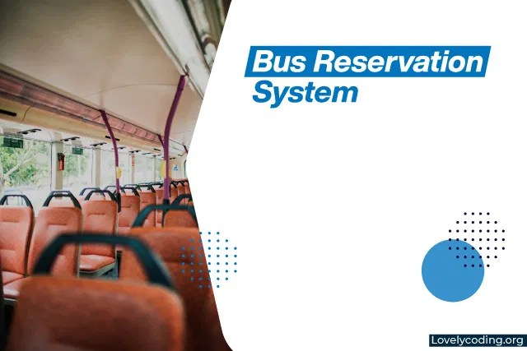
Project Overview
Objective:
Develop a comprehensive bus reservation system that facilitates online booking and management of bus tickets.

Slide 6
Technology View
Building a bus reservation system involves several components from a technology perspective. Below is an outline of how you might approach designing and implementing such a system.
Architecture Overvie
* Frontend
* Backend

Slide 7
Frontend
User Interface (UI): Develop a user-friendly web or mobile interface for customers to search and book bus tickets.
Technologies: HTML/CSS for structure and styling, JavaScript (React, Vue.js) for interactive components.

Slide 8
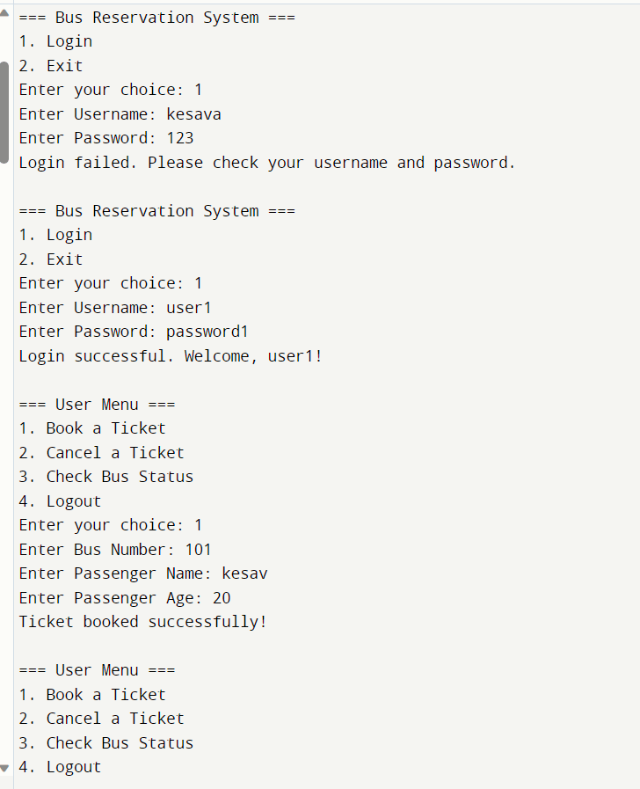
Backend
Application Logic: Handle bus search, booking, and payment processes.
Technologies: Node.js, Python (Django, Flask), Java (Spring Boot), or another suitable backend framework.

Slide 9
System Components:
i. User Interface:
Booking Portal: Allows users to search for buses, select seats, and make reservations.
Registration/Login: Users can create accounts or log in to access booking features.
Payment Gateway: Integration with a secure payment system for transactions.
ii. Backend Services:
Bus Management: CRUD operations for bus schedules, routes, and seat availability.
User Management: Handle user profiles, bookings, and payments.
Search and Filter: Algorithms to find available buses based on user criteria.
iii. Database:
Users: Store user details and booking history.
Buses/Routes: Information about bus schedules, routes, and seat availability.
Bookings: Records of user bookings and transaction details.
2. System Flow:
User Registration/Login:
New users register or existing users log in.
Search for Buses:
Users enter their travel details (source, destination, date).
The system displays available buses matching the search criteria.
Select Seats:
Users choose seats from the available options.
Make Reservation:
Users confirm the booking and proceed to payment.
Payment:
Users pay for the reservation using integrated payment methods.
Confirmation:
Booking details and e-ticket are provided upon successful payment.
Modeling & Result

Slide 10
Expected Results:
i. User Experience:
Seamless booking flow with intuitive UI/UX.
Fast search and seat selection process.
Clear booking confirmation and e-ticket issuance.
ii. Administrative Tools:
Dashboard for bus operators to manage schedules and seat allocations.
Reporting tools to track bookings, revenue, and popular routes.
iii. System Performance:
Scalability to handle multiple users and concurrent transactions.
Robust security measures to protect user data and transactions.
iv. Business Impact:
Increased efficiency in bus ticket sales.
Improved customer satisfaction and retention.
Potential for revenue growth through online bookings.
4. Technology Stack:
Frontend: HTML/CSS, JavaScript (React/Angular/Vue)
Backend: Node.js, Python (Django/Flask), Java (Spring Boot)
Database: MySQL, PostgreSQL, MongoDB
Payment Gateway: Stripe, PayPal, Razorpay
Hosting: AWS, Azure, Google Cloud Platform
5. Development Process:
Requirements Gathering: Understand user needs and system functionalities.
Design: Plan system architecture, database schema, and UI/UX.
Development: Implement frontend, backend, and database components.
Testing: Conduct unit tests, integration tests, and user acceptance tests.
Deployment: Deploy the system on cloud servers or dedicated hosting.
Maintenance: Monitor system performance, fix bugs, and update features.

Slide 11
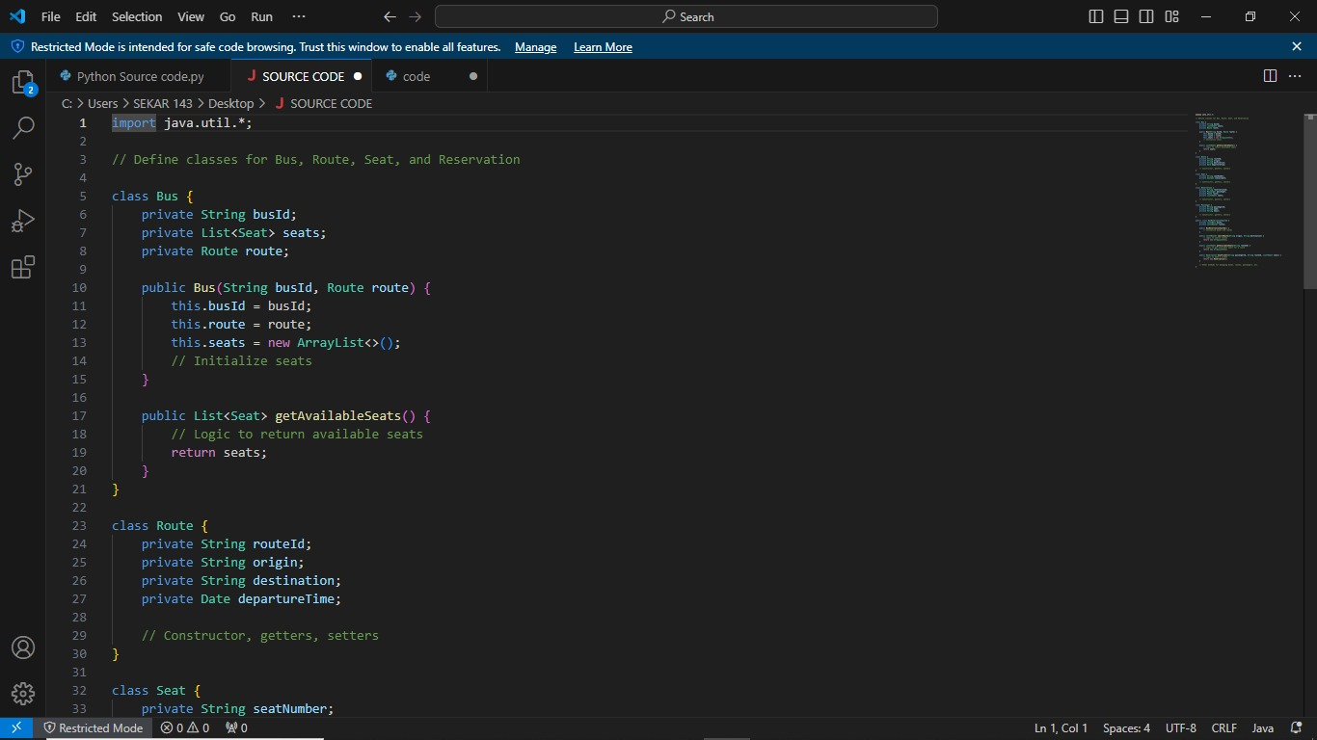

Slide 12
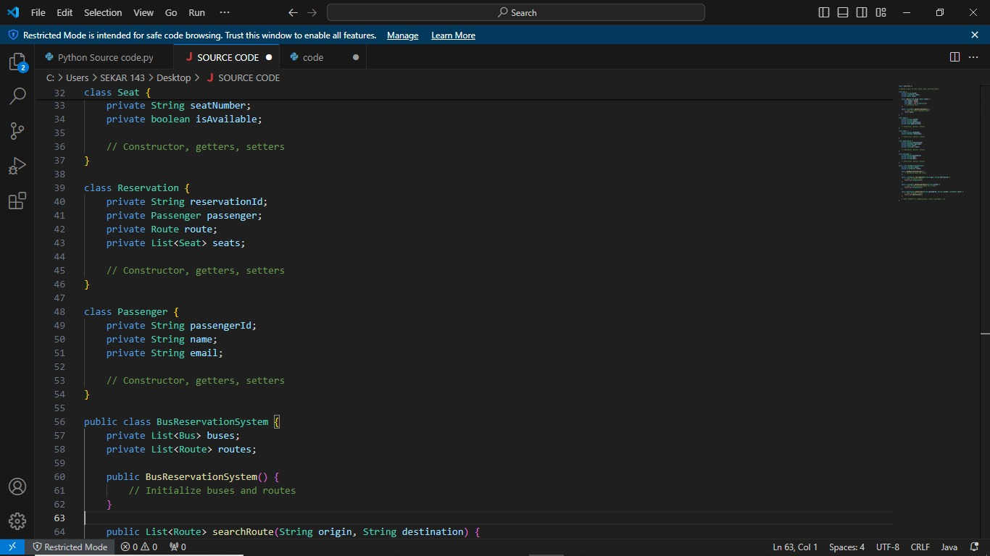

Slide 13
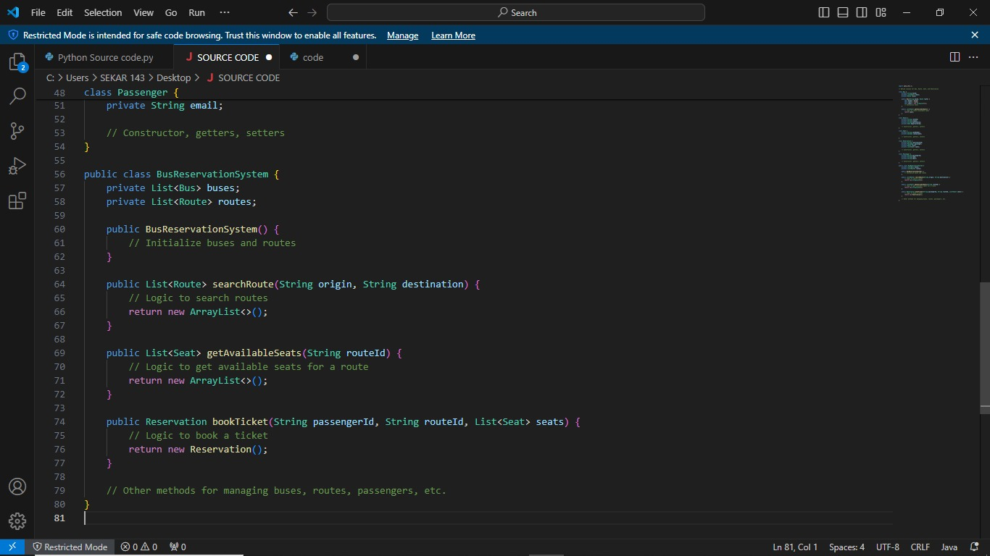

Slide 14
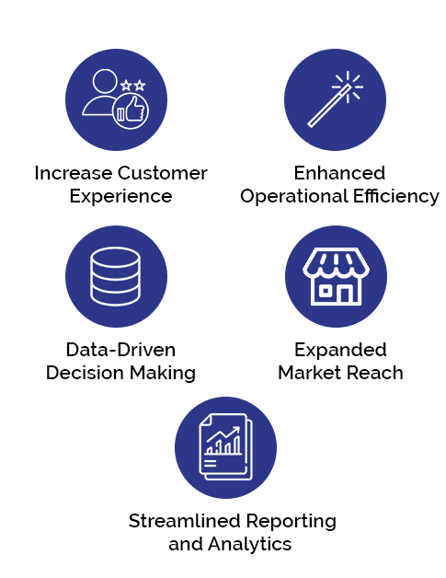
Future Enhancement
Mobile Application: Develop a mobile app for easy booking and management of bus tickets. This can improve accessibility and user experience, allowing passengers to book tickets on-the-go.
User Profiles and Accounts: Implement user accounts to store passenger details and booking history. This can personalize the experience and facilitate quicker bookings for frequent travelers.
Seat Selection: Enable passengers to select specific seats during the booking process. This feature adds convenience and flexibility for passengers.

Slide 15
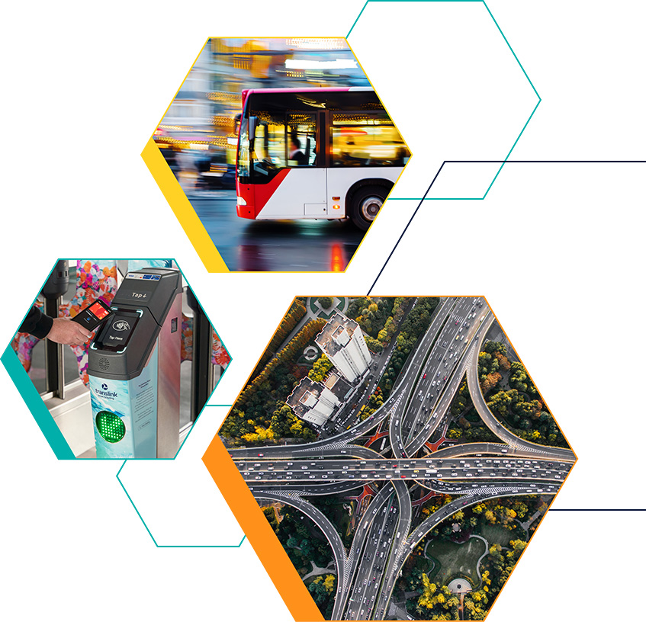
Conclusion
In conclusion, the development and implementation of a bus reservation system bring about several key benefits and advancements in the realm of transportation management:
Efficient Operations: By digitizing the reservation process, the system optimizes bus fleet management and scheduling. Bus companies can efficiently allocate resources, manage seat inventory, and monitor bookings in real-time, leading to improved operational efficiency and reduced overhead costs.
Data-Driven Decision Making: The system provides valuable insights through data analytics. Operators can analyze booking trends, passenger preferences, and route performance, enabling informed decision-making to enhance service quality and optimize routes.

Slide 16
